Slide 1
Software Testing Course’s Code: CSE 453 Test Design Techniques: Decision Table based Testing (Chapter 4)

Slide 2
Decision Table
Specifications often contain business rules to define
functions of the system
conditions or decisions under which each function operates
Individual conditions are simple, but the overall effects of these logical conditions can become quite complex
As testers, we need to able to assure ourselves that every combinations of these conditions might occur has been tested
need to capture all decisions in a way that enables us to explore their combinations
Decision Table is the mechanism that is used to capture the logical decisions in a precise and compact way

Slide 3
Decision Table
A decision table lists all the input conditions that can occur and all the actions that can arise from them
The resulting decision tables are easy to understand, and can be validated by domain experts.
Furthermore, testers can use decision tables for the systematic derivation of test cases,
in order to verify that the system under test correctly implements the required conditional logic.
A decision table is structured into a table as rows
the conditions at the top of the table
possible actions at the bottom
business rules which involve some combinations of conditions to produce some combinations of actions are arranged across the top

Slide 4
Decision Table
 | Rule 1 | Rule 2 | Rule 3
Condition 1 | T | F | T
Condition 2 | T | T | T
Condition 3 | T | dc | F
Action 1 | Y | N | Y
Action 2 | N | Y | Y
A decision table is structured into a table as rows
the conditions at the top of the table
possible actions at the bottom
each column represents a single business rule shows how input conditions are combined to produce actions

Slide 5
Decision Table
 | Rule 1 | Rule 2 | Rule 3
Condition 1 | T | F | T
Condition 2 | T | T | T
Condition 3 | T | dc | F
Action 1 | Y | N | Y
Action 2 | N | Y | Y
Rule 1 requires all conditions to be true to generate action 1
Rule 2 results in action 2 if condition 1 is false and condition 2 is true, but does not depends on condition 3
Rule 3 requires conditions 1 and 2 to be true and condition 3 to be false
Hyphen “dc” in decision table represents a “don’t care” entry.

Slide 6
Example-Phone Subscriptions
A Dutch phone company, lets users click various options and then determines a price per month.
The price per month is determined by two conditions. The conditions are:
whether the subscription is for national, which is cheaper, or international, more expensive, that’s on the first row
the second condition is whether the customer is willing to renew automatically, which would also be cheaper.
At the bottom in bold, we see the actual outcome or action, as determined by the conditions. In this case the outcomes are different monthly prices.

Slide 7
Example-Phone Subscriptions
In this example, there are 4 rules
The first rule describes the cheapest subscription, 10 Euros per month, limited to national usage and with an obligation to automated renewal
The fourth column is the most expensive one, 32 Euros per month with usage across the world, and the possibility to cancel any moment.

Slide 8
Example-Phone Subscriptions
As a slightly more complex example, consider an extra condition, shown in the third row.
If you as a potential buyer are a loyal customer already, you deserve a reduction.
Here, we assume a customer can either get loyalty reduction, or auto-renewal reduction, but not both.
 | Rule 1 | Rule 2 | Rule 3 | Rule 4 | Rule 5 | Rule 6
International? | F | F | F | T | T | T
Auto-renewal? | T | dc | F | T | dc | F
Loyal? | dc | T | F | dc | T | F
Price/month | 10 | 10 | 15 | 30 | 30 | 32

Slide 9
Example-Phone Subscriptions
The first column indicates that if we have auto-renewal already, T-value, whether the customer is loyal as well does not matter, DC-value.
Likewise, if the customer is loyal, second column, picking auto-renewal makes no difference.
 | Rule 1 | Rule 2 | Rule 3 | Rule 4 | Rule 5 | Rule 6
International? | F | F | F | T | T | T
Auto-renewal? | T | dc | F | T | dc | F
Loyal? | dc | T | F | dc | T | F
Price/month | 10 | 10 | 15 | 30 | 30 | 32

Slide 10
Example-Phone Subscriptions
These don't care values are essentially an abbreviation for two separate columns, for the true and false case, which are identical except for the DC value.
If we expand each DC-value, we get, in this table, 4 extra variants or columns.
We can see that variants one and three are exactly the same, even though they were derived from expansions of different DC-cells, shown in orange.
The table is in this case well designed, in the sense that these two variants share the same action, the reduced price is 10 Euros in both cases.
 | Rule 1 | Rule 2 | Rule 3 | Rule 4 | Rule 5 | Rule 6
International? | F | F | F | T | T | T
Auto-renewal? | T | dc | F | T | dc | F
Loyal? | dc | T | F | dc | T | F
Price/month | 10 | 10 | 15 | 30 | 30 | 32
Expand

Slide 11
Example-Phone Subscriptions
If we omit the duplicate columns we arrive at the simpler table shown here. With three conditions and 8 variants it shows the maximum number of variants.
Expanded and De-Duplicated

Slide 12
Example-Phone Subscriptions
In general, if we have N conditions, rows, this leads to 2^N possible variants, columns.
The mobile plan example given here is relatively simple, with just three conditions.
Decision tables in practice can have many more conditions. For example, the actual mobile plan has several more conditions, bandwidth limits, phone minutes, type of previous subscription, etc. This then easily leads to at least six conditions and 2^6 = 64 variants.

Slide 13
Example-Phone Subscriptions: Testing Decision Table
How to create test cases from a decision table?
Two ways
create one test case per variant (Column) listed in the table
Or
MC/DC Coverage: Modified Condition / Decision coverage.

Slide 14
Example-Phone Subscriptions: Testing Decision Table
MC/DC demands the following: Every condition should yield both true and false, Every outcome or action should be taken at least once, Every condition should be shown to individually determine the decision outcome,

Slide 15
Example-Phone Subscriptions: Testing Decision Table

Slide 16
Example-Phone Subscriptions: Testing Decision Table

Slide 17
Example-Phone Subscriptions: Testing Decision Table
4 Test Cases are: V2,V4,V8 and V7.

Slide 18
Example-Phone Subscriptions: Testing Decision Table

Slide 19
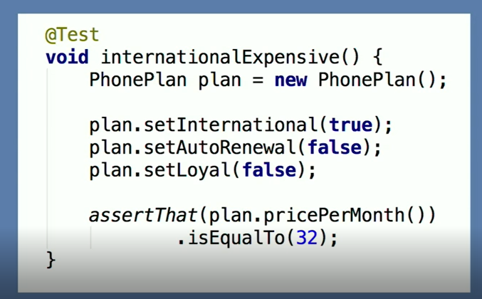
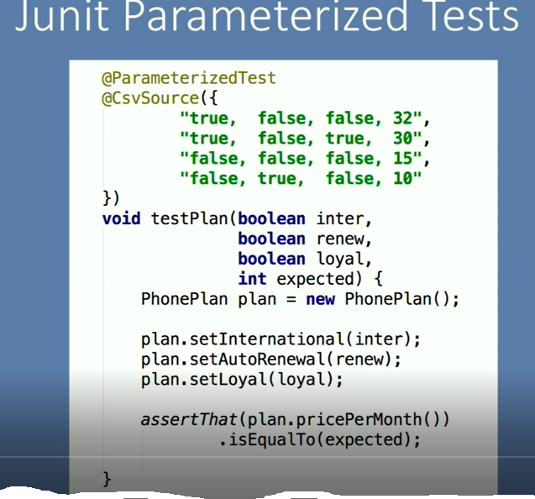
Implementation of Decision Table based Testing

Slide 20
Example 2 - Decision Table based Testing
A supermarket has a loyalty schema that is offered to all customers.
Loyalty cardholders enjoy the benefits of either additional discounts on all purchases or the acquisition of loyalty points
Loyalty points can be converted into vouchers for the supermarket or to equivalent points in schemas run by partners
Customers without a loyalty card receive an additional discount only if they spend more that $100 on any one visit to the store
otherwise only the special offers offered to all customers apply

Slide 21
Example 2 - Decision Table based Testing
 | RULE 1 | RULE 2 | RULE 3 | RULE 4 | RULE 5
Customer loyalty card? | T | T | T | F | F
Special Offer selected? | T | F | F | T | F
Spend>$100 | dc | dc | dc | T | F
Additional Discount | F | F | T | T | F
Loyalty Points-Voucher | F | T | F | F | F
Loyalty Points-Equivalent Points | T | F | F | F | F
Special offer applied | T | F | F | T | F
Conditions
Actions
5 Test Cases are: Rule 1, Rule 2, Rule 3, Rule 4, Rule 5. (Without applying MC/DC)

Slide 22
Example 3 - Decision Table based Testing
The triangle program accepts three integers, a, b, and c, as input
These are taken to be the sides of a triangle
The integers a, b, and c must satisfy the following conditions:
C1: a<b+c
C2: b<a+c
C3: c<a+b
The output of the program may be: Equilateral, Isosceles, Scalene, Not-a-triangle and Impossible

Slide 23
Example 3- Decision Table based Testing
 | R1 | R2 | R3 | R4 | R5 | R6 | R7 | R8 | R9 | R10 | R11
a<b+c? | F | T | T | T | T | T | T | T | T | T | T
b<a+c? | - | F | T | T | T | T | T | T | T | T | T
c<a+b? | - | - | F | T | T | T | T | T | T | T | T
a=c? | - | - | - | T | T | T | F | T | F | F | F
b=c? | - | - | - | T | T | F | T | F | T | F | F
a=b? | - | - | - | T | F | T | T | F | F | T | F
Not a triangle | T | T | T
Scalene |  |  |  |  |  |  |  |  |  |  | T
Isosceles |  |  |  |  |  |  |  | T | T | T
Equilateral |  |  |  | T
Impossible |  |  |  |  | T | T | T
Conditions
Actions
11 Test Cases are: R1-R11. (Without applying MC/DC)

Slide 24
Example 4- Decision Table Based Testing
A mutual insurance company has decided to float its shares on the stock exchange and is offering its members rewards for their past custom at the time of flotation
Anyone with a current policy will benefit provided it is a ‘with-profits’ policy and they have held it since 2001
Those who meet these criteria can opt for either a cash payment or an allocation of shares in the new company
Those who have held a qualifying policy for less than the required time will be eligible for a cash payment but not for shares.

Slide 25
Example 4- Decision Table Based Testing
 | Rule 1 | Rule 2 | Rule 3 | Rule 4
Current policy holder | Y | Y | Y | N
Policy holder since 2001 | N | Y | N | dc
‘With-profits’ policy | Y | Y | N | dc
Eligible for cash payment | Y | Y | N | N
Eligible for share allocations | N | Y | N | N
Conditions
Actions
4 Test Cases are: RULE1-RULE4

